Slide 1
INDUSTRIAL MANAGEMENT Chapter 12
CSE 417 Section 15/AB Term II
Session 2017-18
Department of Computer Science and Engineering
Instructor: Arif S. Bhuiyan, MSEd

Slide 2

Introduction to Project Management
Information Technology Project Management, Seventh Edition
Thanks to Maj Dr Muhammad Nazrul Islam
CSE Dept, MIST

Slide 3
Advantages of Using Formal Project Management
Better control of financial, physical, and human resources
Improved customer relations
Shorter development times
Lower costs
Higher quality and increased reliability
Higher profit margins
Improved productivity
Better internal coordination
Higher worker morale

Slide 4
What Is a Project?
A project is “a temporary endeavor undertaken to create a unique product, service, or result” (PMBOK® Guide, Fifth Edition, 2012)
Operations is work done in the organization to sustain the business
Projects end when their objectives have been reached or the project has been terminated
Projects can be large or small and take a short or long time to complete

Slide 5
Examples of IT Projects
A team of students creates a smartphone application and sells it online
A company develops a driverless car
A small software development team adds a new feature to an internal software application for the finance department
A college upgrades its technology infrastructure to provide wireless Internet access across the whole campus

Slide 6
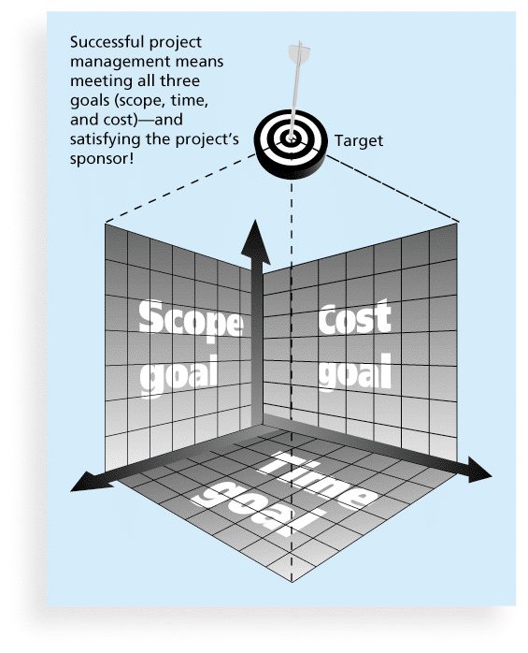
Figure 1-1 The Triple Constraint of Project Management

Slide 7
What is Project Management?
Project management is “the application of knowledge, skills, tools and techniques to project activities to meet project requirements” (PMBOK® Guide, Fourth Edition, 2012)
Project managers strive to meet the triple constraint (project scope, time, cost and quality goals)
also facilitate the entire process to meet the needs and expectations of project stakeholders

Slide 8
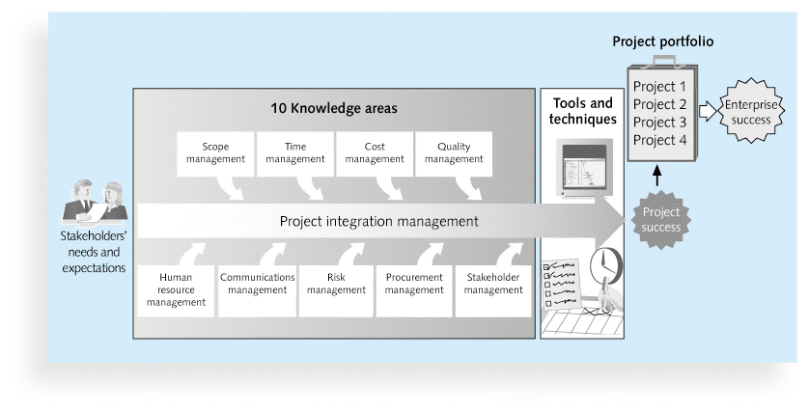
Figure 1-2 Project Management Framework

Slide 9
10 Project Management Knowledge Areas
Knowledge areas describe the key competencies that Project Managers must develop
Project managers must have knowledge and skills in all 10 knowledge areas:
Project integration, scope, time, cost, quality, human resource, communications, risk, procurement, and stakeholder management

Slide 10
The 10 knowledge areas of project management
1. Project scope management involves defining and managing all the work required to complete the project successfully.
2. Project time management includes estimating how long it will take to complete the work, developing an acceptable project schedule, and ensuring timely completion of the project.
3. Project cost management consists of preparing and managing the budget for the project.
4. Project quality management ensures that the project will satisfy the stated or implied needs for which it was undertaken.
5. Project human resource management is concerned with making effective use of the people involved with the project.

Slide 11
The 10 knowledge areas of project management
6. Project communications management involves generating, collecting, disseminating, and storing project information.
7. Project risk management includes identifying, analyzing, and responding to
risks related to the project.
8. Project procurement management involves acquiring or procuring goods and services for a project from outside the performing organization.
9. Project stakeholder management includes identifying and analyzing stakeholder needs while managing and controlling their engagement throughout the life of the project.
10. Project integration management is an overarching function that affects and is affected by all of the other knowledge areas.

Slide 12
Project Success
There are several ways to define project success:
The project met scope, time, and cost goals
The project satisfied the customer/sponsor
The results of the project met its main objective, such as making or saving a certain amount of money, providing a good return on investment, or simply making the sponsors happy

Slide 13
Table 1-2: What Helps Projects Succeed?*
1. User involvement
2. Executive support
3. Clear business objectives
4. Emotional maturity
5. Optimizing scope
6. Agile process
7. Project management expertise
8. Skilled resources
9. Execution
10. Tools and infrastructure
*The Standish Group, “CHAOS Activity News” (August 2011).

Slide 14
Program and Project Portfolio Management
A program is “a group of related projects managed in a coordinated way to obtain benefits and control not available from managing them individually” (PMBOK® Guide, Fifth Edition, 2012)
A program manager provides leadership and direction for the project managers heading the projects within the program
Examples of common programs in the IT field include infrastructure, applications development, and user support

Slide 15
Project Portfolio Management
As part of project portfolio management, organizations group and manage projects and programs as a portfolio of investments that contribute to the entire enterprise’s success
Portfolio managers help their organizations make wise investment decisions by helping to select and analyze projects from a strategic perspective

Slide 16
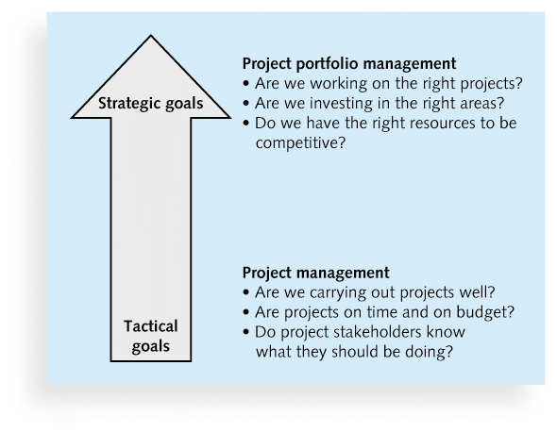
Figure 1-3. Project Management Compared to Project Portfolio Management

Slide 17
Table 1-3 Ten Most Important Skills and Competencies for Project Managers
1. People skills
2. Leadership
3. Listening
4. Integrity, ethical behavior, consistent
5. Strong at building trust
6. Verbal communication
7. Strong at building teams
8. Conflict resolution, conflict management
9. Critical thinking, problem solving
10. Understands, balances priorities

Slide 18
Ethics in Project Management
Ethics, loosely defined, is a set of principles that guide our decision making based on personal values of what is “right” and “wrong”
Project managers often face ethical dilemmas
In order to earn PMP certification, applicants must agree to PMI’s Code of Ethics and Professional Conduct
Several questions on the PMP exam are related to professional responsibility, including ethics

